Slide 1

Neonics: TO BEE OR NOT TO BEE?
A STUDY ON THE IMPACT OF PESTICIDES ON U.S. HONEYBEE colonies

Slide 2
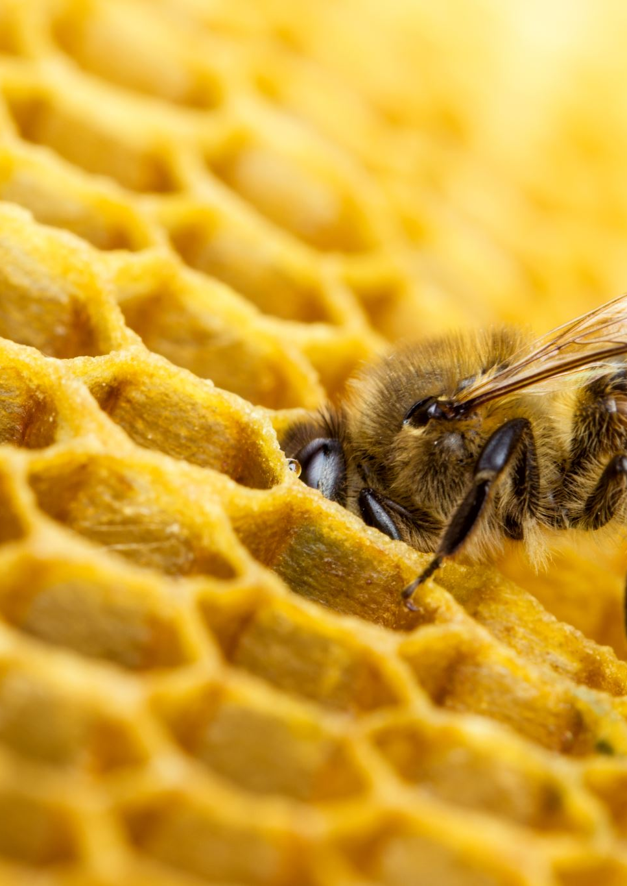
Agenda
The Business Question
The Data
Summary
The Model
Project Background

Slide 3
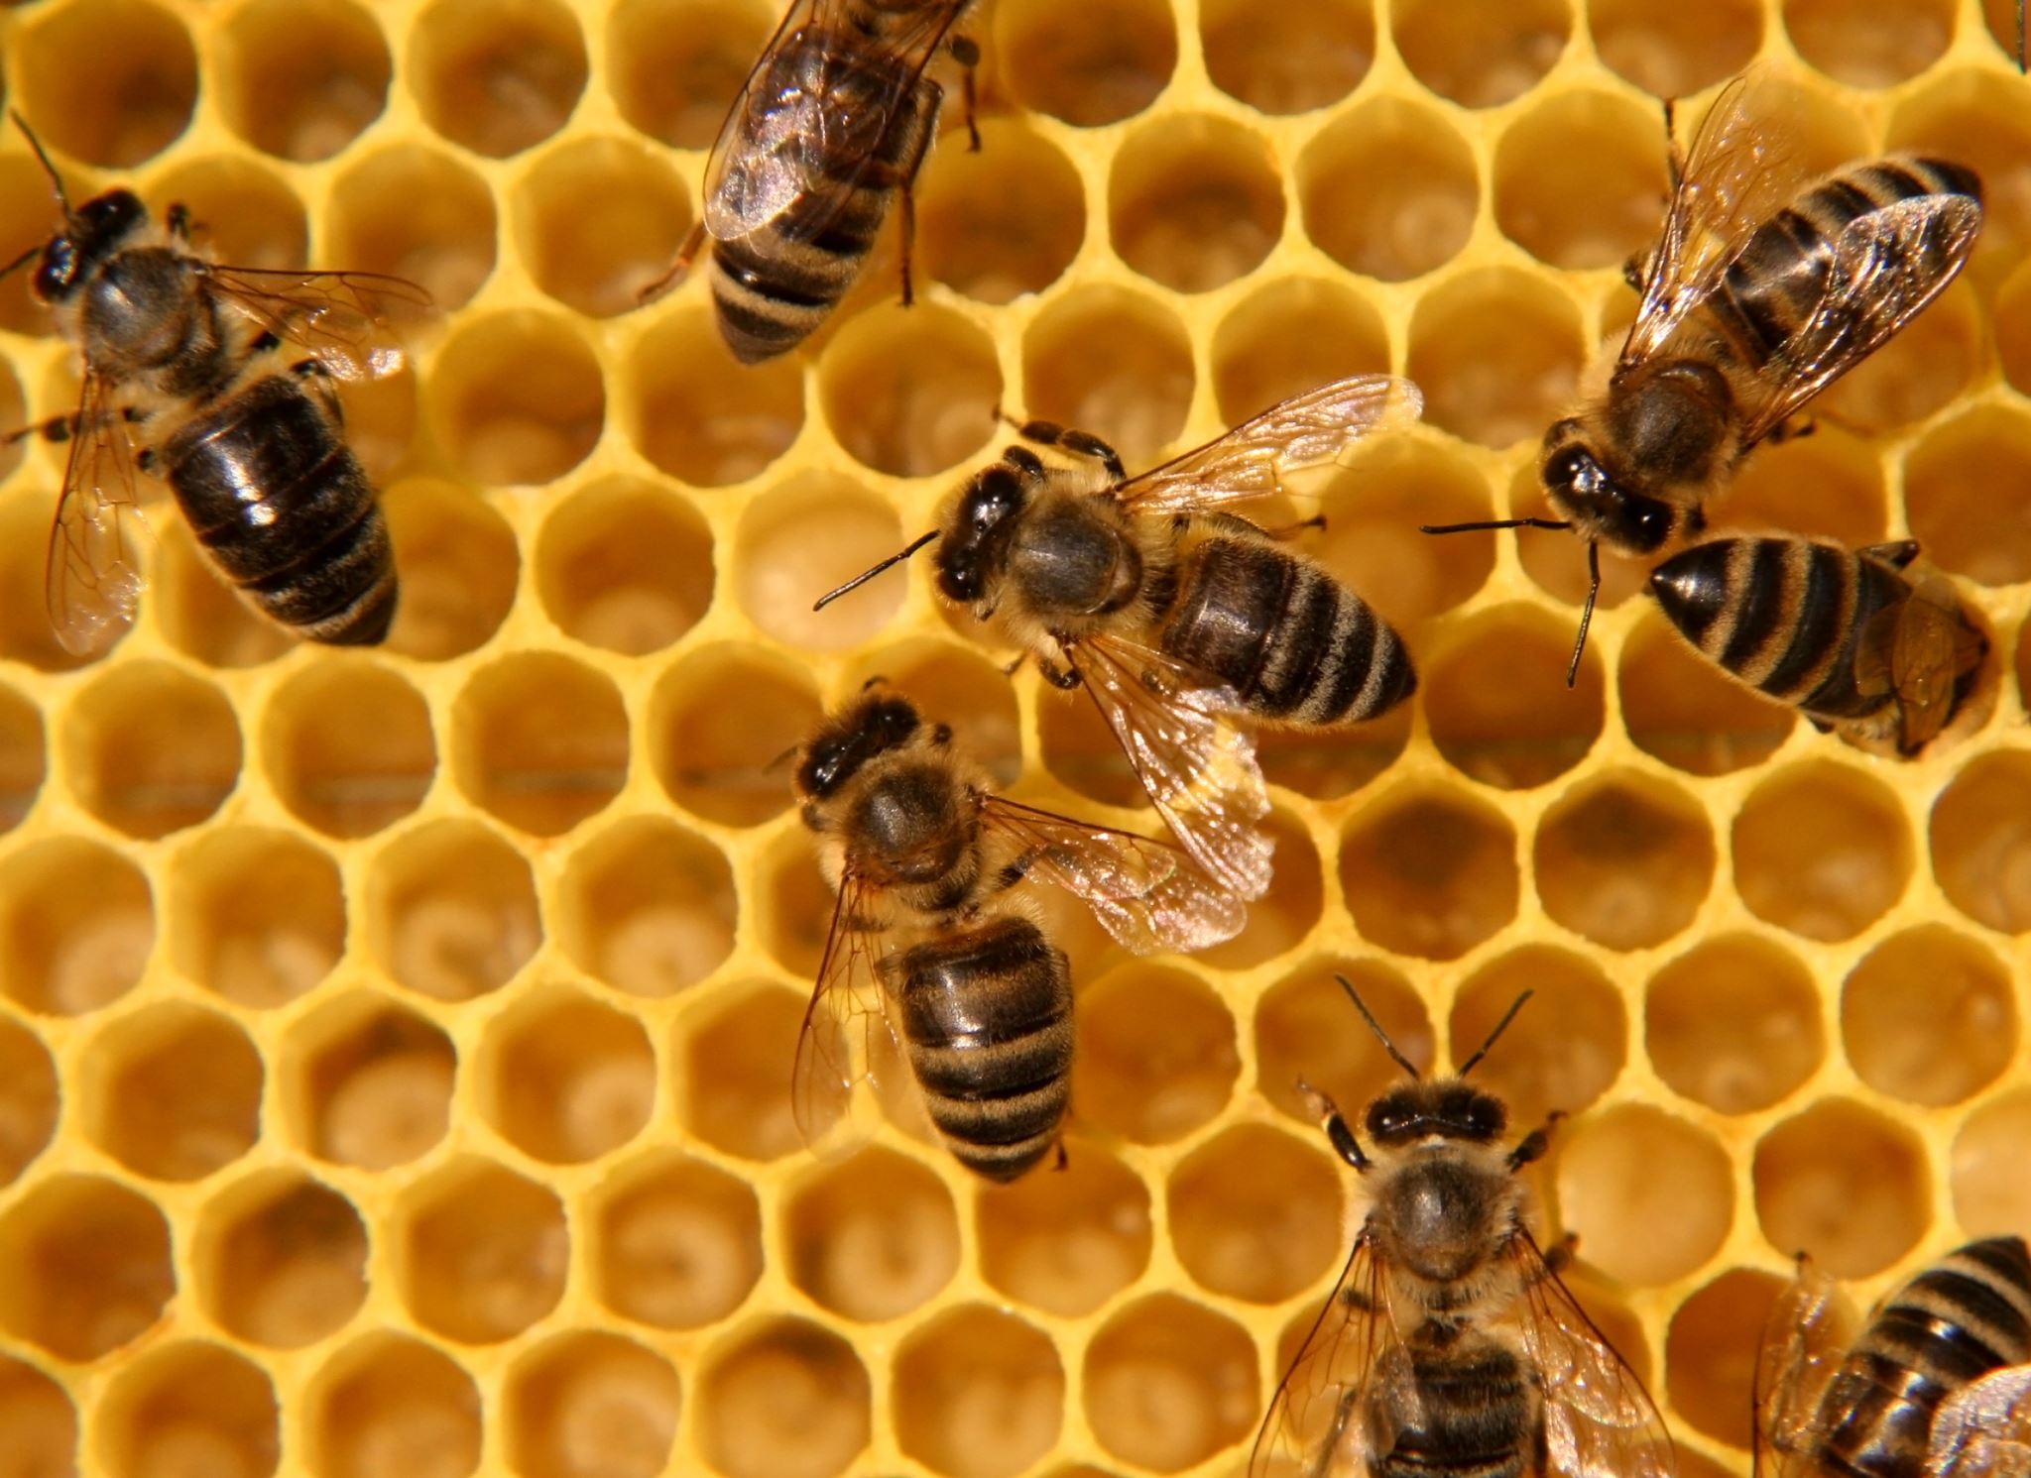

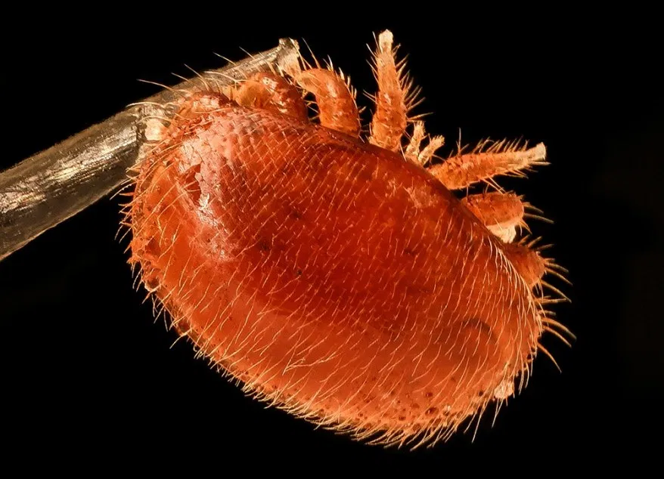
Project background
Colony Collapse Disorder (CCD) Impacts:
Decline in # of colonies
Honey yield per colony decreased
Price of honey increased
Notes:
Honey bee (Apis mellifera) colony numbers (15% reduction) and production per colony (1/3 reduction) have declined since the early 1990s
Total production of honey in the U.S. is down by more than a quarter since 1991
Price of honey has increased at more than double inflation in the same timeframe
The main cause - Colony Colapse Disorder (CCD)
2 key factors contributing to CCD:

Slide 4
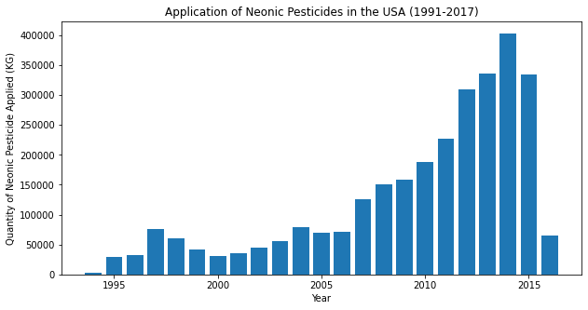
Use of Neonic Pesticides in the USA 1991-2017

Slide 5
Agenda
Project Background
The Business Question
Summary
The Model
The Data

Slide 6
Business Question / Data Question
Stakeholders: Honey producers, Farmers, Consumers, Environmental Protection Agencies
How can we increase U.S. Honeybee colony output to 'pre-neonic levels' recorded in the year 2000? A value of $8.8bil to the U.S. honey market.
Which factors determine/impact individual colony performance? How can we use these to predict honey yield?
Notes:
73mil pounds less of honey produced by colonies from 2000 and 2017.
At current figures of $120 per pound of honey, this is worth $8.8bil

Slide 7
Agenda
Project Background
The Business Question
Summary
The Model
The Data

Slide 8
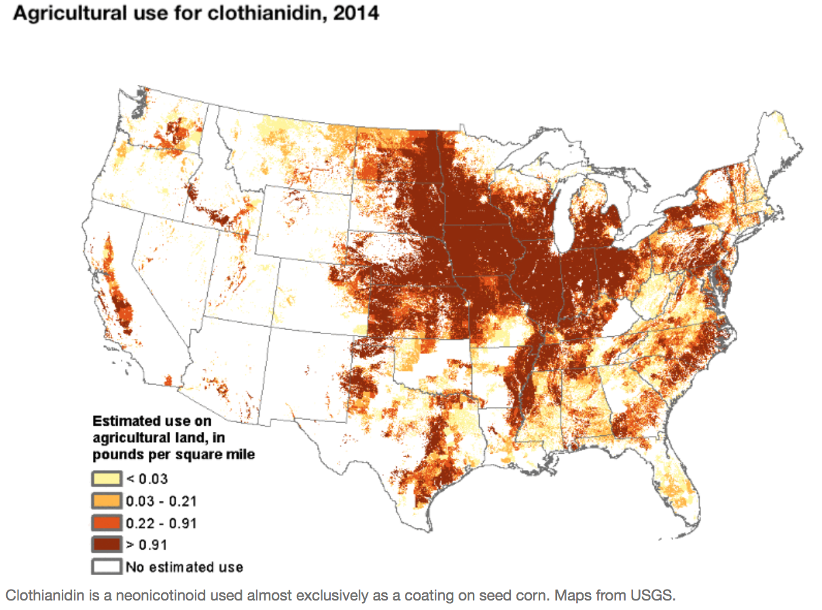
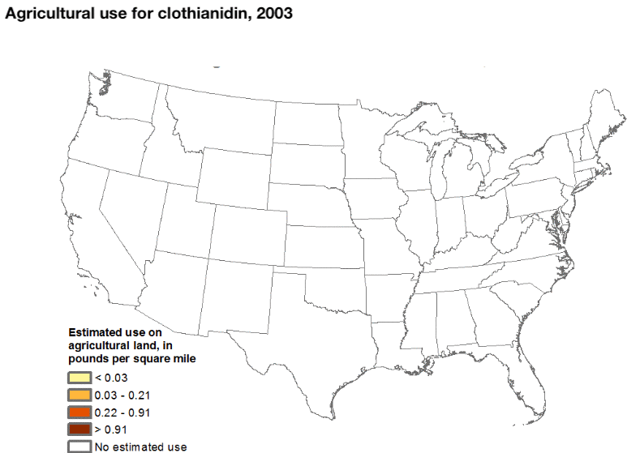
Comparison of Neonics 2003-2014

Slide 9
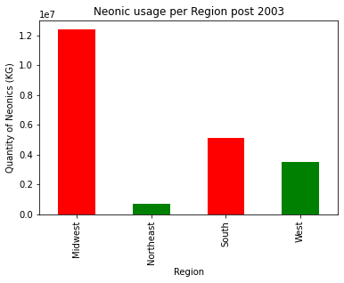
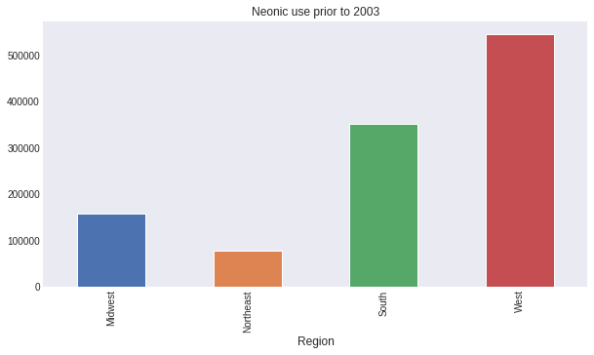
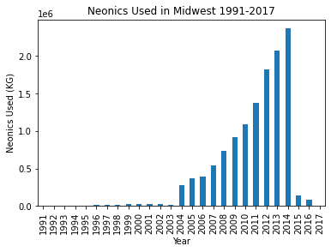
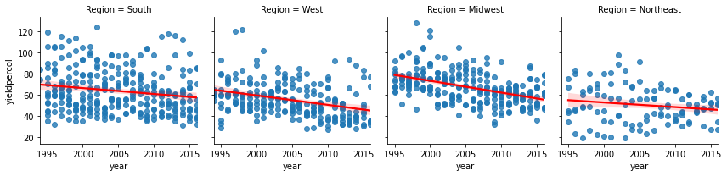
Midwest Honey Data
262 data points (National Agricultural Statistics Service & U.S. Geological Society)
Total production of honey in the US down by 73 billion pounds / 33bil KG
Notes:
Data formed by the concatenation of two datasets – Honey production per hive, per state and neonic usage per state.
Normalisation required on the nAllNeonic variable (used Square Root to achieve this)
Neonics adopted early on (1990's) in the Western states (primarily California) but swung to the farm-dominated midwest in the early 2000's.

Slide 10
Agenda
Project Background
The Business Question
Summary
The Model
The Data

Slide 11










Stakeholders
Business Question
Business Answer
Data
Question
Data Answer
Data Analysis
Feature Selection
Model & validate
Data
Solution

Slide 12
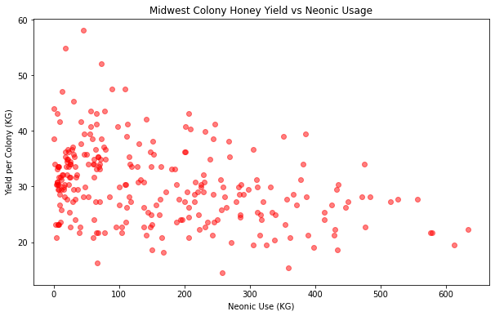
Yield vs Neonic Usage
Notes:
More explanitory rather than predictive in terms of model.
We see the inverse relationship between neonic usage and colony performance
Need more data and features to fully understand the relationship between the two.

Slide 13
Summary
Discovery
Suggestions
CCD HAS RESULTED IN A DIVE IN THE U.S. HONEY MARKET
THREE KEY MARKERS SUPPORTING THIS:
Decline in colony numbers –15%
Decreased total honey production –30%
Price per lb of Honey increased at over 2X the rate of inflation
EVIDENCE OF ADVERSE EFFECTS FROM NEONIC PESTICIDES ON PER-COLONY HONEY PRODUCTION
To Beekepers: Move colonies away from treated areas (organic farms, etc.) >12km
To Farmers: Reduce Neonic usage on crops
To Regulators: Ban use of Neonics

